Slide 1
Dimension reduction Clustering
2018/04/02

Slide 2
Dimension reduction
Visualization
Compressing the data
Finding a informative representation
Dimension reduction -> Clustering

Slide 3
PCA(Principal Component Analysis)
It rotates the dataset in a way such that the rotated features are statistically uncorrelated.
The direction of the first principal component is the biggest variance(eigenvalue) vector.
The direction of the second principal component is orthogonal to first principal component’s direction.

Slide 4
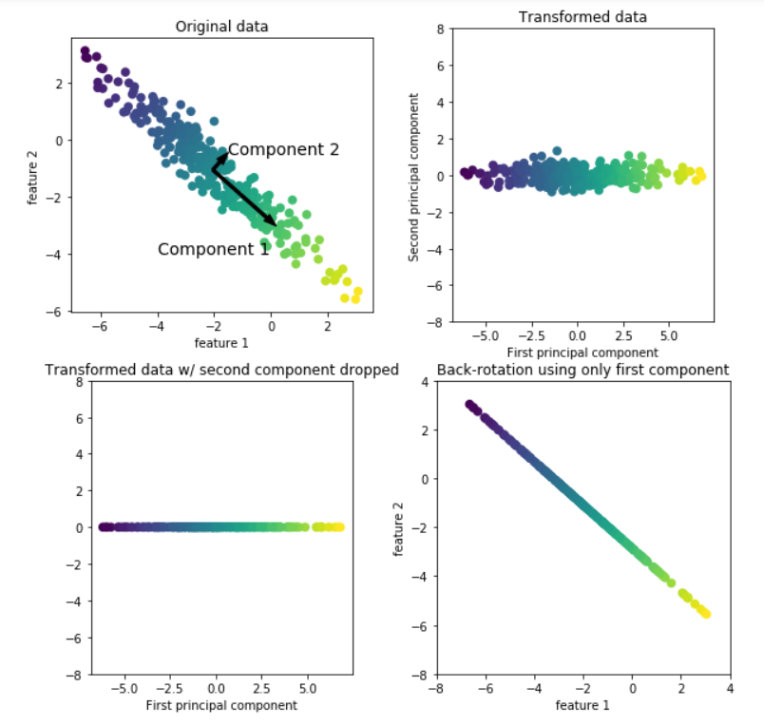
PCA(Principal Component Analysis)

Slide 5
NMF(Non-Negative Matrix Factorization)
This is another unsupervised learning algorithm that aims to extract useful features.
Actually, commonly used for feature extraction.
It can be also used for dimensionality reduction.
The thing that we will obtain is the coefficients to be non-negative.
This method can only be applied to data where each feature is non-negative.

Slide 6
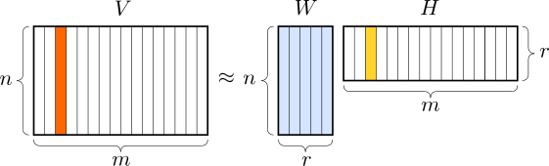
NMF(Non-Negative Matrix Factorization)

Slide 7
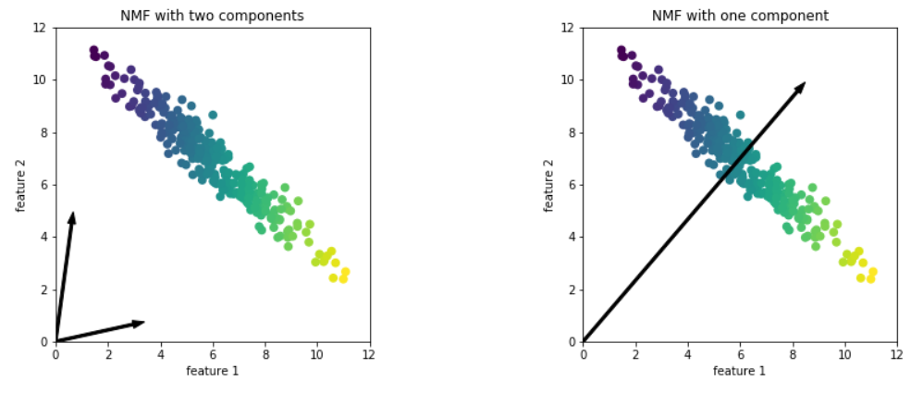
NMF(Non-Negative Matrix Factorization)

Slide 8
t-SNE(Stochastic Neighbor Embedding) 가까운건 더 가깝게 먼건 더 멀게 projection
t-SNE is mainly used for visualization(It is useful for EDA).
It only transform the training data rather than test data(It doesn’t allow transformations of new data).
The key idea is to find a two-dimensional representation of the data that preserves the distances between points as best as possible.
It makes the distance closer if two data points are close each other and farther if two data points are far from each other.

Slide 9
Autoencoder
Unsupervised learning algorithm that applies backpropagation, setting the target values to be equal to the inputs.
It is trying to learn an approximation to the identity function.
It has encode part and decode part.
It can be used for feature extraction.
It has many variation such as denoising autoencoder, stacked autoencoder, variational autoencoder etc.

Slide 10
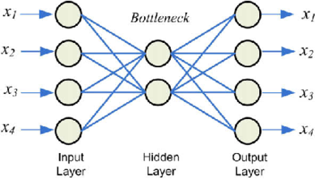


Autoencoder

Slide 11
Clustering
Unsupervised learning method that partitions the dataset into group called cluster.
Well clustered means that points within a single cluster are very similar and points in different clusters are different.

Slide 12
Hierarchical Clustering
It has two types for hierarchical clustering.
Agglomerative Clustering
Divisive Clustering (전체에서 자르면서 하는거 )
Scikit-learn supports agglomerative clustering for hierarchical clustering.
It starts by declaring each point its own cluster, and then merges the two most similar clusters until some stopping criterion is satisfied.

Slide 13
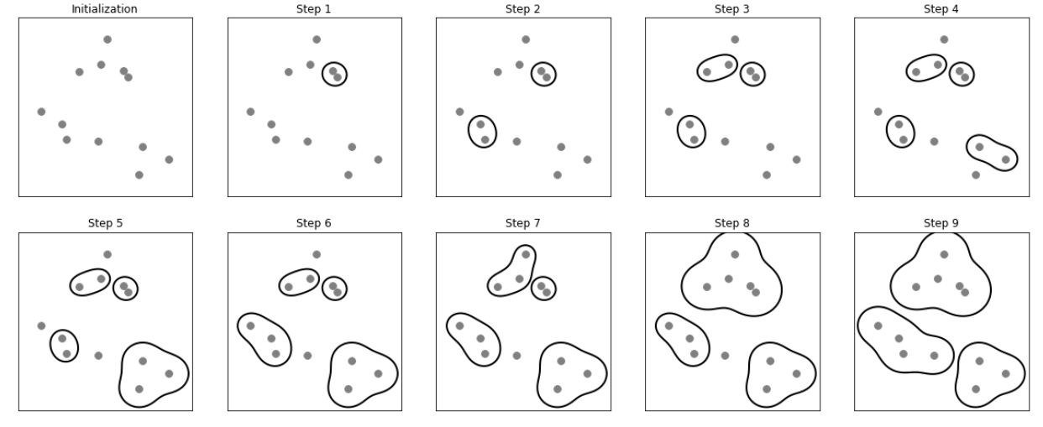
Hierarchical Clustering

Slide 14
K-Means Clustering
It is one of the simplest and most commonly used clustering algorithm.
It tries to find cluster centers that are representative of certain regions of the data.
It has two steps:
Step 1 : Assigning each data point to the closest cluster center
Step 2 : Setting each cluster center as the mean of the data points that are assigned to it
It repeats until when the assignment of instances to clusters no longer changes.

Slide 15
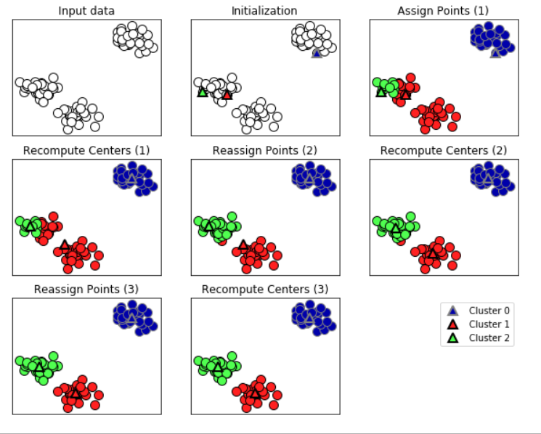
K-Means Clustering

